Slide 1
Level-Up Your Test-fu with BDD and SpecFlow
James Bender
Product Manager, Infragistics
www.IgniteUI.com
@JamesBender

Slide 2

Another unit testing framework?!
Really?
REALLLLYYYYY?
I already do TDD, so…….

Slide 3

Notes:
http://www.flickr.com/photos/dieselbug2007/414348333/sizes/l/in/photostream/

Slide 4

Notes:
http://www.flickr.com/photos/marklincoln/5435427346/sizes/o/in/photostream/

Slide 5


Slide 6


Slide 7
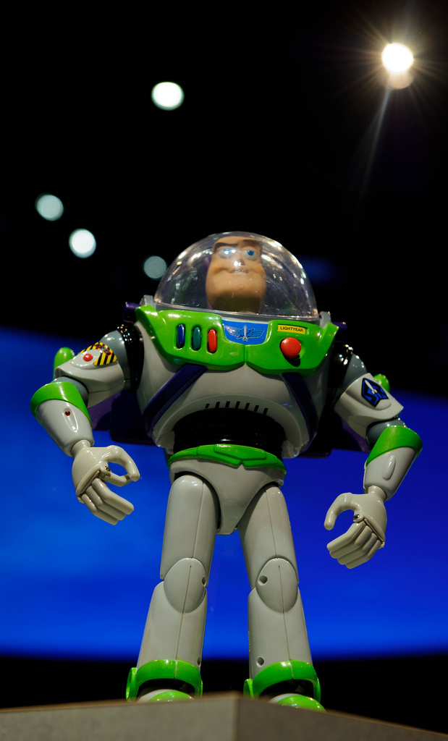
AND BEYOND!!
Test Driven Development
Notes:
http://www.flickr.com/photos/nasahqphoto/6881364014/sizes/l/in/photostream/

Slide 8
Behavior Driven Development (BDD)
Acceptance Test Driven Development (ATDD)

Slide 9
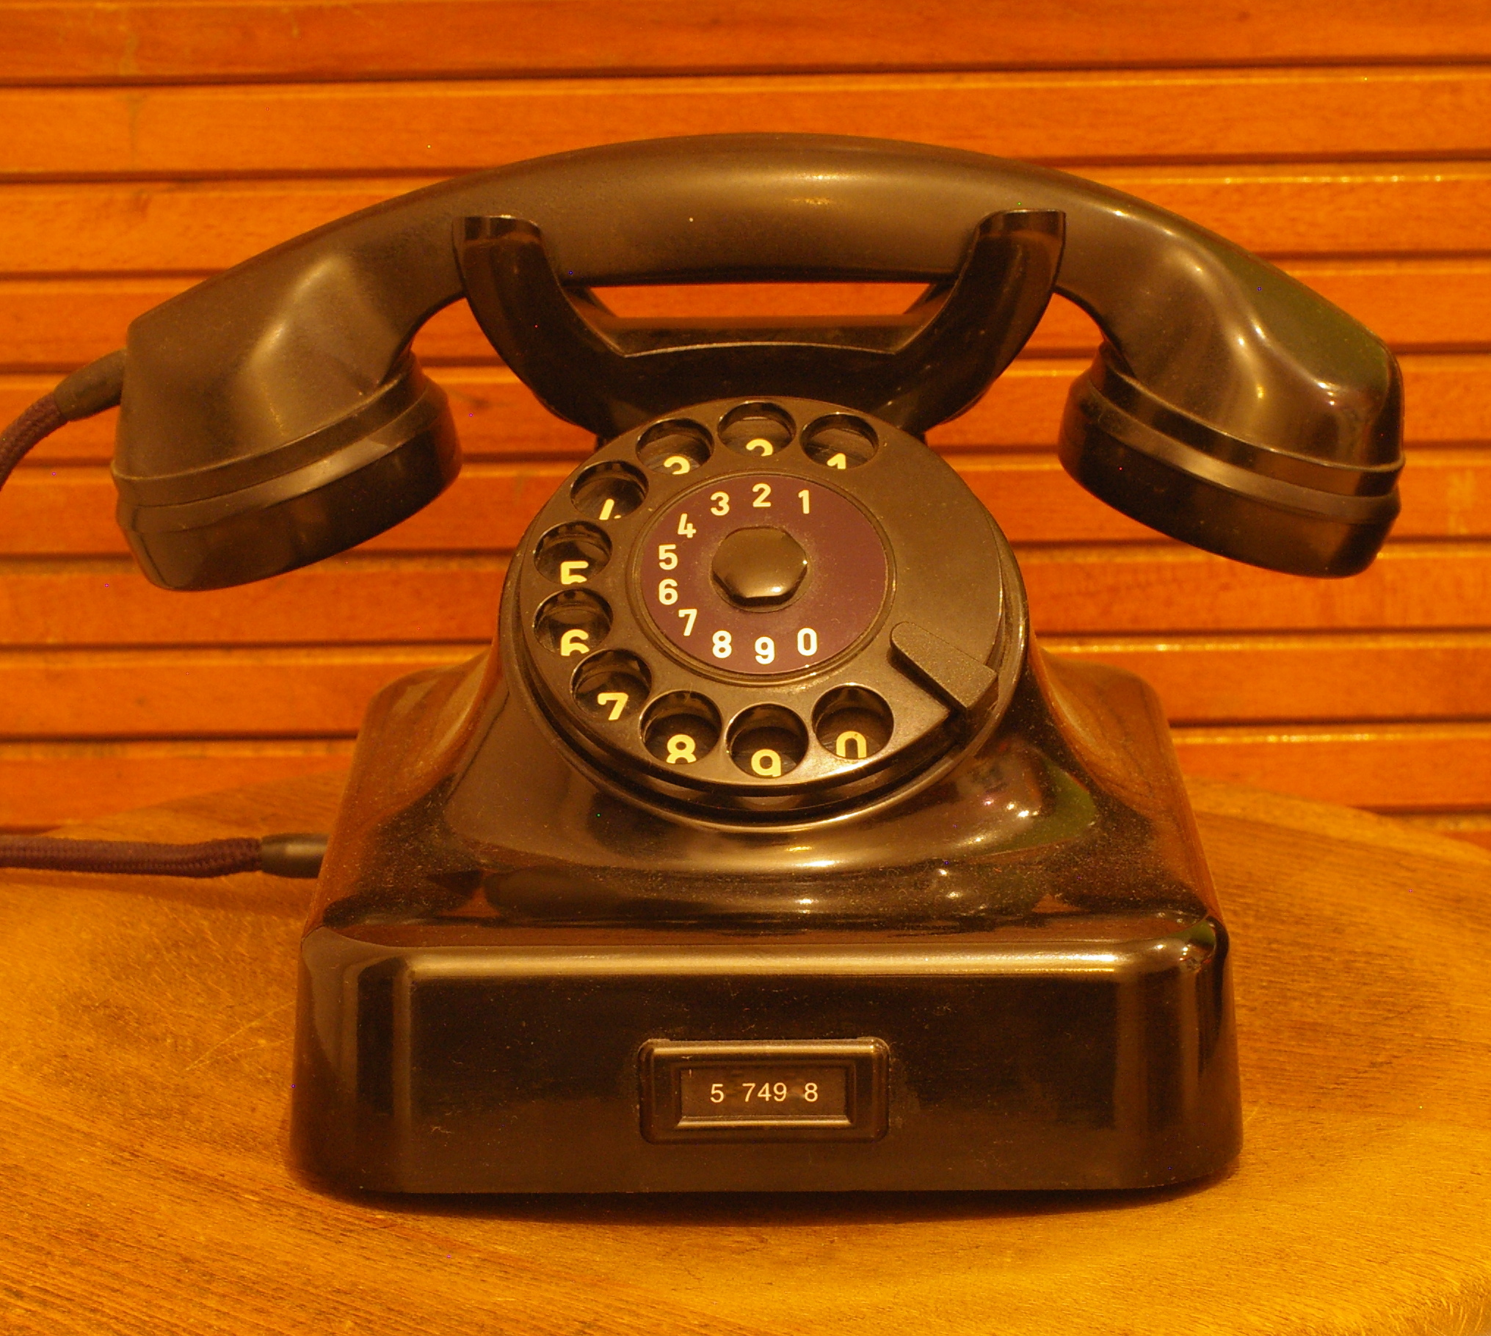
Notes:
https://www.flickr.com/photos/plenty/3360322975/in/photolist-8Gr2P8-67WwX2-aqSegk-4VsfA7-kt7CB-81U3gV-8HWE8N-797Gsi-iDZbuk-CLofj-6tnQpE-81aXPr-Cok9U-8iykgq-6x44US-53rB7P-Kq7Q-6GaRg2-9wNUt-ta4iM-6xn4ys-7jVnGd-938KAK-9JKQF4-fCzVVf-cFMzho-cFMxvE-cFMEBQ-cFMuzA-cFMCD5-cFMLky-cFMDCN-cFMByf-cFMvP3-cFMywY-cFMG6E-cFMJNb-cFMvg3-cFMNdu-cFMKCS-cFMMem-cFMAj3-ALcWD-E5SQ6-BgMkr-sXpX-9SKSe1-cFMwFj-cFMHK7-5vCiXQ/

Slide 10


Slide 11
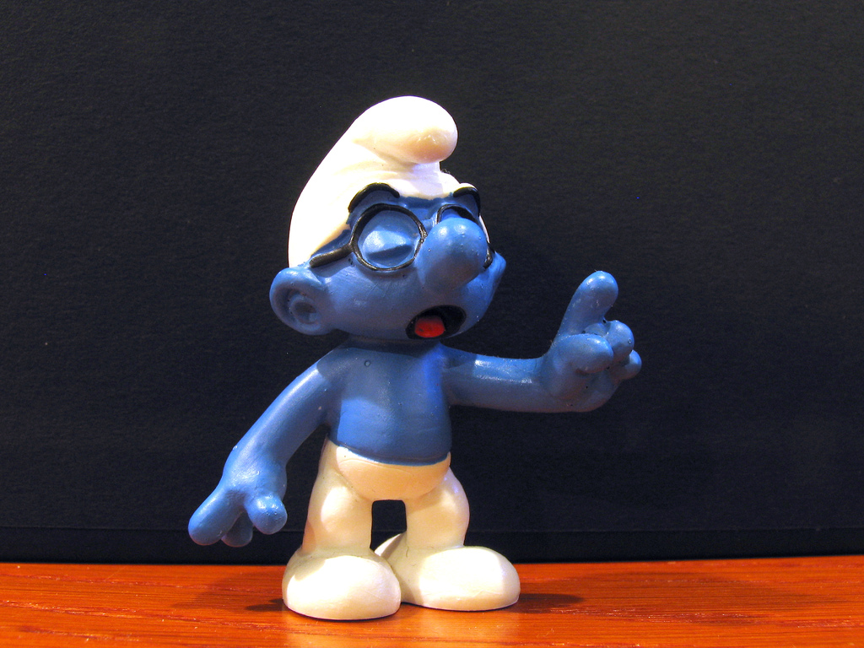
That’s not what I would have named it…
You shouldn’t use that tool for this…
That’s not how your work flow is supposed to be.
That is not
how you’re supposed to do this!

Slide 12
Demo: Tic-Tac-Toe
Create a library to determine the winner of a Tic-Tac-Toe game
Input is a multidimensional array of string:
string[3, 3] { {' ', ' ', ' '},
{' ', ' ', ' '},
{' ', ' ', ' '} };
Returns the winner token (X || O) as a string or an empty string in the rare case of a draw

Slide 13
Supporting Concepts
Mocking
Dependency Injection

Slide 14


Slide 15
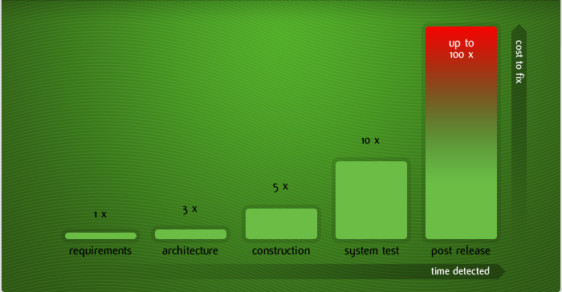
Cost of fixing a defect and when

Slide 16
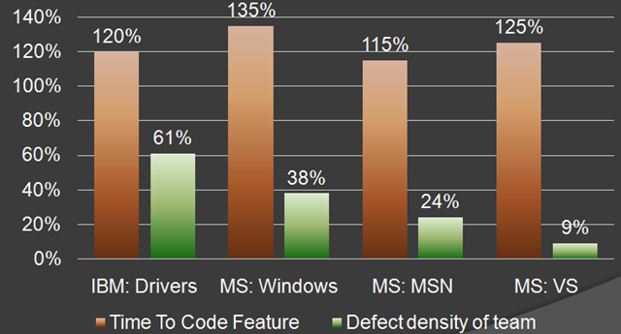
MS & IBM

Slide 17
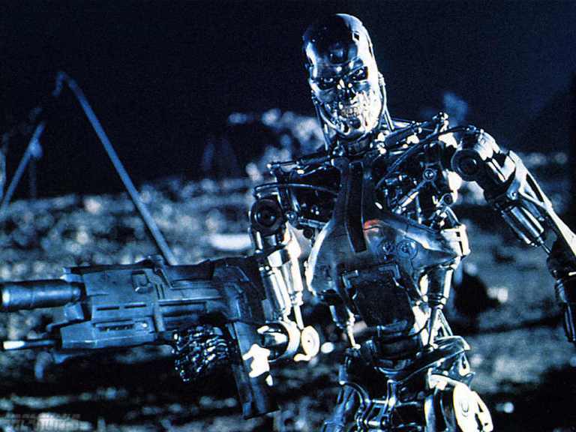

Slide 18
Next Actions..
Look at a the different mocking frameworks and dependency injection frameworks
Start by writing tests for new features and defects

Slide 19

Thank you!
Want to learn more?
www.IgniteUI.com
www.JamesCBender.com
github.com/JamesBender
james@jamescbender.com
Twitter: @JamesBender
hallwayconversations.com

